Slide 1
TCN workload design <WiE internal Use>
Workload Integration and Enabling (WiE) PRC team
April 20, 2022

Slide 2
Contents
WL Arch and SW Stack.
Benchmark and KPI.
Resource Usage.
POD Design and Provisioning.
CPU Scaling.
Run Stages.
Configurations.
Readme Section.
Next Steps.
2

Slide 3
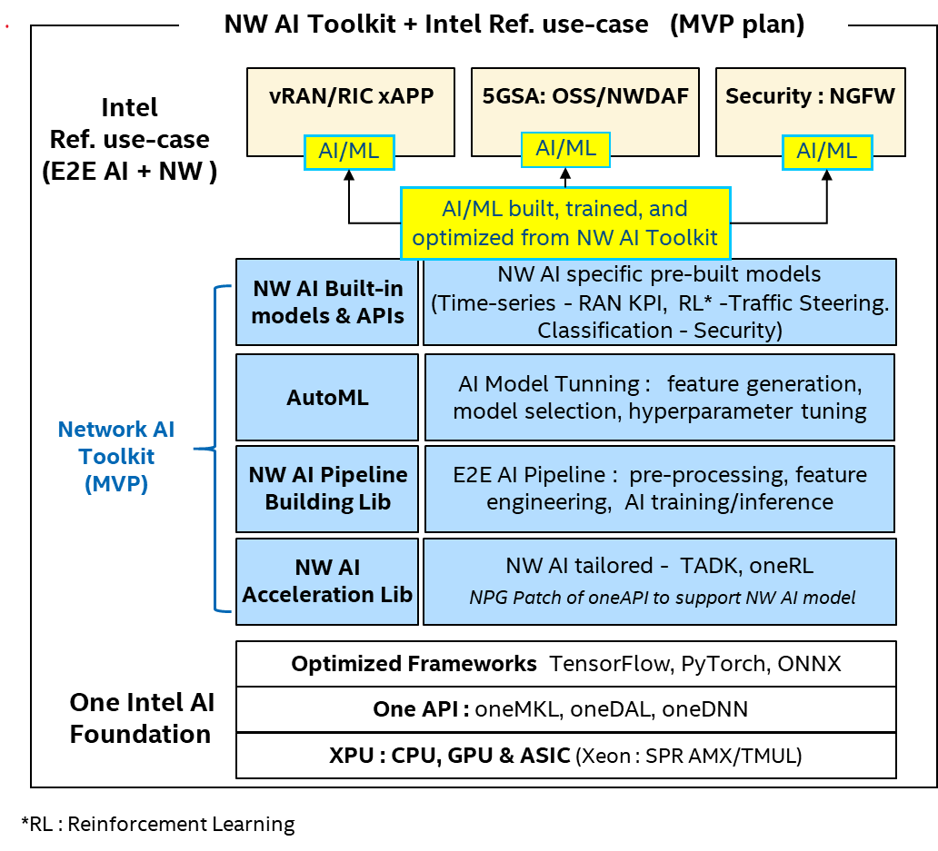
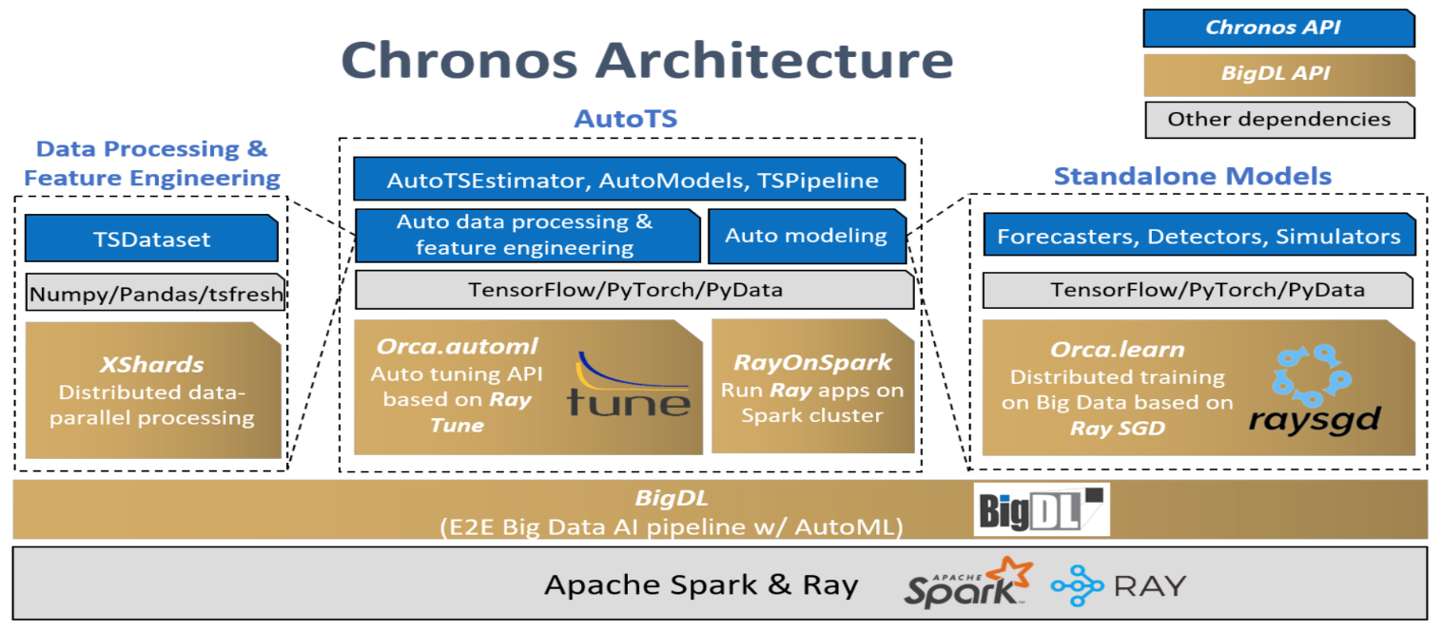
WL Design – WL Arch and SW Stack
Network AI is one of the vertical market for Intel AI Strategy & Execution, and NW AI Toolkit will on-board Developer on Intel throughout the entire AI lifecycle.
This workload contains TCN based on Chronos, which is a toolkit that involves AI models build on multiple frameworks like Pytorch and TensorFlow. Chronos also applies distributed training on TCN to accelerate training process through BigDL with Spark and Ray.
TCN
3

Slide 4
WL Design – WL Arch and SW Stack
TCN is short for Temporal Convolutional Network, which achieves superior or competitive performance on Time series (TS) analysis tasks.
TCN demonstrates that the convolutional architecture outperforms canonical recurrent networks such as LSTMs on a series of seq2seq tasks.
TCN applies modern architectures like dilated convolutions and residual connections to achieve very deep networks and very long effective history.
Input data
Temporal Block
Convolution layer
+
Dropout layer
+
ReLU layer
…
Downsample layer
Temporal Block
Convolution layer
+
Dropout layer
+
ReLU layer
Output layers
Output data
4

Slide 5
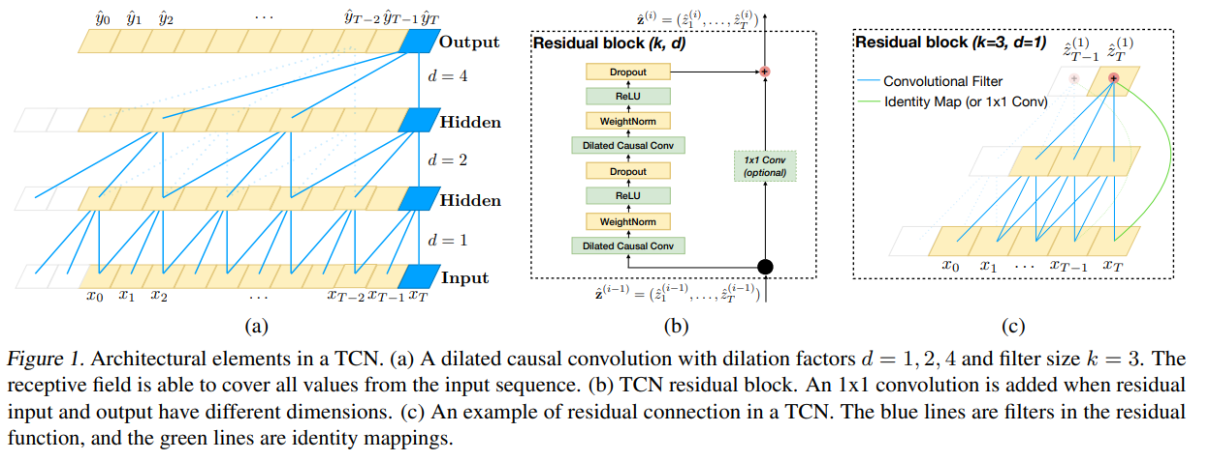
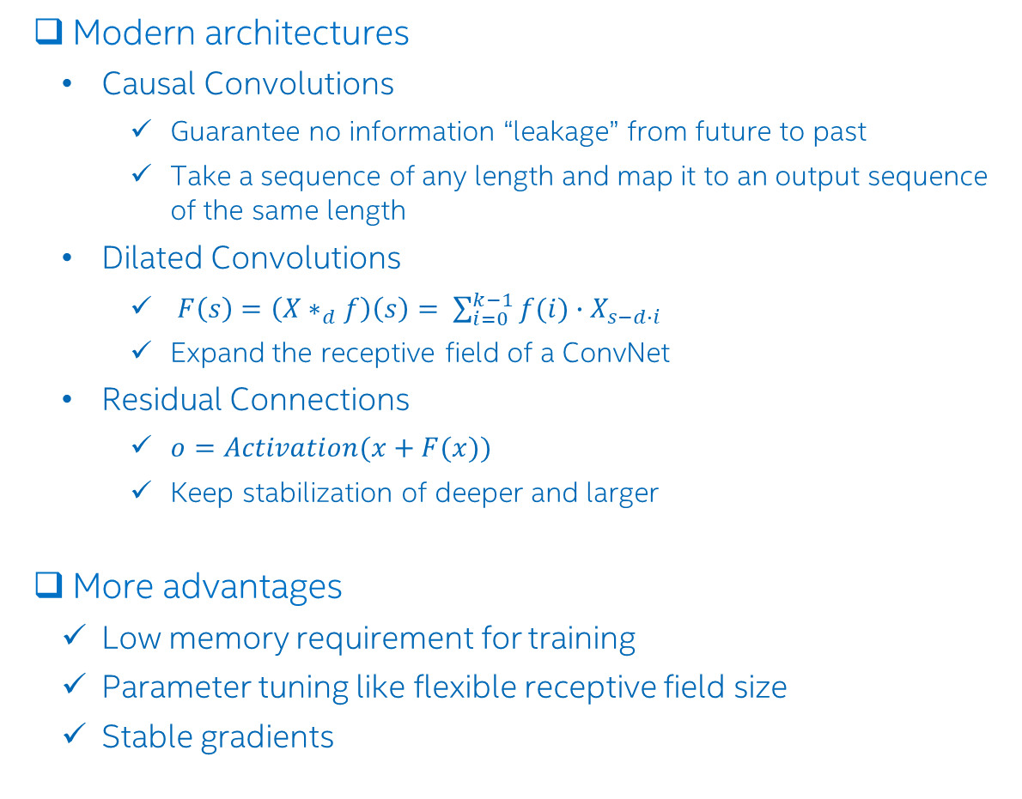
WL Design – WL Arch and SW Stack (continue)
Modern architectures
Causal Convolutions
Guarantee no information “leakage” from future to past
Take a sequence of any length and map it to an output sequence of the same length
Dilated Convolutions
$F\left(s\right)=\left({X∗}_{d}f\right)\left(s\right)= \sum_{i=0}^{k−1}{f(i)∙X_{s−d∙i}}$
Expand the receptive field of a ConvNet
Residual Connections
$o=Activation(x+F(x))$
Keep stabilization of deeper and larger
More advantages
Low memory requirement for training
Parameter tuning like flexible receptive field size
Stable gradients
5

Slide 6
WL Design – WL Arch and SW Stack
Time series analysis is critical to improve the Quality of Service in network. However, traditional analysis methods always fail to predict network congestion facing increasingly complex network environments. And that is why we need TCN.
With the ability of AI technologies, TCN can:
achieve strong performance on long-term && large amount of data
Be integrated into multiple platforms such as RAN MAC and xAPP in near-RT RIC.
Strengthen XEON LRP to accelerate market adoption.
Customers demands:
Capgemini and AsiaInfo.
6

Slide 7

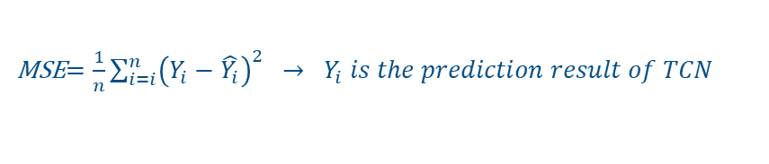
WL Design – Benchmark and KPI
Benchmark KPIs:
Inference: latency, throughput
Training: MSE
Benchmark is based on NW AI Toolkit (multiple frameworks) for data comparison analysis :
Chronos (Intel Pytorch && ONNX)
OpenVINO (inference only)
Test cases
Test cases for Chronos: latency_avx_inference_chronos_pkm && throughput_avx_inference_chronos && mse_avx_training_chronos
Test case for OpenVINO: latency_avx_inference_openvino && throughput _avx_inference_openvino && mse _avx_openvino
Benchmark configuration categories
System configs
Model/Software configs
$$Latency\left(primary\right)=\text{time}\text{ (}\text{ms}\text{) }\text{required} \text{to} \text{process} \text{a} \text{single} \text{input}$$
Throughput $=\frac{inferred number of data}{processing time in seconds}$
MSE$=\frac{1}{n}\sum_{i=i}^{n}{{\left(Y_{i}−\hat{Y_{i}}\right)}^{2} → Y_{i} is the prediction result of TCN}$
$\hat{Y_{i}}$ is the ground truth of TCN input data
7

Slide 8
WL Design – Resource Usage
Testing platform has two sockets with 128 cores and 128G memory. NUMA is applied to bind cores.
EMON and HTOP will be used to monitor the workload and extract system data
Item | Platform Configuration
 | (ICL)
CPU | Intel(R) Xeon(R) Platinum 8358 CPU @ 2.60GHz
Memory | 128G
CPU MHz | 3400
CPU max MHz | 3400
CPU min MHz | 800
L1d cache | 3 MiB
L1i cache | 2 MiB
L2 cache | 80 MiB
L3 cache | 96 MiB
OS | Ubuntu 21.04
NUMA nodes​ | 2
Cores per Node | 64
NUMA Memory | bind local(64 GB per node)​
NUMA Balancing | Enable
Hyper-Threading | Enable
8

Slide 9
WL Design – POD Design and Provisioning
The workload is deployed on a single k8s node. It is better to use 64 cores && 12G memory for training and 8 cores && 6G memory for inference.
Performance work scope of the workload will include Bare Metal and gen-to-gen.
TCN
Parameters | Necessary Resources
CPU | 64 cores for training 1/2/4/8 cores for inference
Memory | 12G for training 6G for inference
Workload
Container
Ubuntu 20.04
Backend
Docker / K8S (one node)
Host OS
Ubuntu 20.04
Hardware
CPU (ICX/SPR)
9

Slide 10
WL Design – CPU Scaling
Scaling ability of inference process is needed because inference is directed related to industry deployment.
Configures Comparation Full Sweep
CPU Scaling Benchmarking will start from 1C1T to 8C8T.
ICIT | 2C2T | 4C4T | 8C8T
10

Slide 11
WL Design – Run Stages
Time-based setup stages
These stages includes setup of docker && k8s, data loading and model preparation. The Workload does not contain these time in calculation of KPI.
About 5 minutes for each test case.
Warm up stage
TCN with OpenVINO does not have the warm up stage.
TCN with Chronos and TCN based on Pytorch && TF contain warm up stage, and this time can be calculated separately.
About 1 minutes for each test case.
Formal execution stage
Formal execution stage indicates training process and inference process of TCN model
About 5 hours for training and 10 minutes for inference.
11

Slide 12
WL Design – Configurations: HW Config
Hardware configuration tuning focuses on the CPU frequency because this workload is CPU-Intensive and not sensitive to parameters like memory.
Default System Config | CPU​ | Intel(R) Xeon(R) Platinum 8358 CPU @ 2.60GHz​
 | Memory​ | 128G​
 | Freq​ Range | 800MHz - 3.4 GHz​
 | NUMA nodes​ | 2​
 | Cores per Node​ | 64​
 | Numa Memory​ | bind local (64 GB per node)​
 | OS​ | Ubuntu 20.04​
 | Hyper-Threading | Enable
 | Numa Balancing | Enable
 | Governor | performance
 | Freq​ency Set | 3.4GHz
 | Huge Page Number | N/A
 | Inference Core Used | 1, 2, 3, 4,
 | Training Core Used | 64
Tuned System Config
Governor | Frequency Set | High Frequency | Low Frequency
Performance | 3.4GHz | N/A | N/A
On demand | N/A | 3.4GHz | 2.6GHz
12

Slide 13




WL Design – Configurations: SW Config
Software configuration tuning explores how the parameters within model && data flow can influence the KPI.
Tuned model Config
$$matrix of data points with shape:$$
All these parameters will be exposed in the next PR.
Kernel Size | 3/5/7
Levels | 5/6/7/8/9
Hidden Units | 36/48/60/72
Dropout | 0/0.1/0.2
Learning Rate | 0.001/0.002/0.004
Batch Size | 128/256/512/1024
$$[input time ste, featured,batch size]$$
Input data
Temporal Block
$${level}_{1}$$
$$∗hidden units$$
$$∗hidden units$$
$${level}_{2}$$
…
$$…$$
Default Software/Model Config
Category | Parameter | Value
Training | Batch Size | 512
 | Learning Rate | 0.001
 | Epoch | 30
Model | Kernel Size | 3
 | Levels | 8
 | Hidden Units | 48
 | Dropout | 0.1
 | Optimizer | Adam
 | Loss | MSE
Business | Input Time Step (lookback) | 320/640
 | Output Time Step (horizon) | 40
$$kernel size$$
Temporal Block
$${level}_{n}$$
$$matrix of data points with shape:$$
$$[output time ste, batch size]$$
Output layers
Output data
Dropout | Hidden Units | Kernel Size | Levels | Train Batch Size | Learning Rate | Latency (ms) | Throughput (item/s) | MSE
0.1 | 48 | 3 | 8 | 512 | 0.001 | 0.28 | 3539.06 | 1.0
0.1 | 48 | 3 | 7 | 512 | 0.001 | 0.24 | 4188.06 | 1.19
This example shows that a smaller level result in a smaller latency and larger MSE.
13

Slide 14
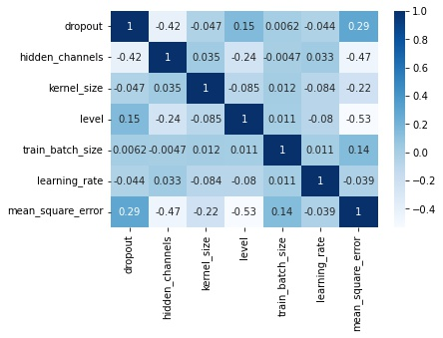

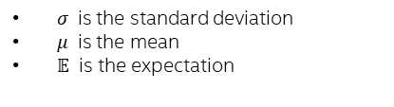
WL Design – TCN Model Level OPT. Methods
Correlation of Parameters can be calculated after a couple of testing. A positive/negative correlation means that the two variables are positively/negative correlated. A zero value means that two variables are independent.
For example, the 0.29 correlation between dropout and MSE indicates that when we increase dropout, MSE would increase slightly.
For example, the -0.53 correlation between level and MSE shows that when we have a larger level, the MSE would decrease.
Correlation help us better select and tune parameters. It is obviously that finer adjustment to a parameter is necessary when KPI is more sensitive to it.
correlation between dropout and mse
correlation between level and mse
$$ρ_{X,Y}=\frac{𝔼[(X−μ_{X})(Y−μ_{Y})]}{σ_{X}σ_{Y}}$$
$σ$ is the standard deviation
$μ$ is the mean
$𝔼$ is the expectation
Dropout | Hidden Units | Kernel Size | Levels | Train Batch Size | Learning Rate | MSE
0.1 | 48 | 3 | 8 | 512 | 0.001 | 1.0
0.1 | 48 | 3 | 7 | 512 | 0.001 | 1.19
Dropout | Hidden Units | Kernel Size | Levels | Train Batch Size | Learning Rate | MSE
0.1 | 48 | 3 | 8 | 512 | 0.001 | 1.0
0.0 | 48 | 3 | 7 | 512 | 0.001 | 0.97
14

Slide 15
WL Design – Readme sections
Readme is mainly divided into following parts:
Introduction
Test Case Basic information and instruction
Docker Image of this workload
KPI
Performance BKM
Contact
Index Info Additional information
Validation Notes
See Also
15

Slide 16
Next Steps
Competitive Analysis with AMD .
INT8 enabled && oneDNN enabled for comparison analysis.
Benchmarking and performance tuning.
NW AI Toolkits upgrade
16

Slide 17

Photo Example On Lower Half
Thank You
17

Slide 18
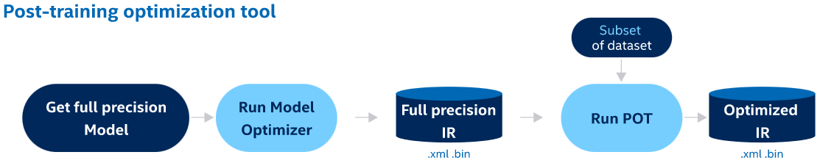
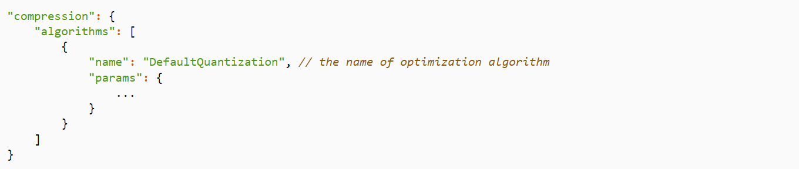
Inference
TCN Benchmarking and Comparison data analysis:
Frameworks: Chronos(Intel Pytorch && ONNX) VS OpenVINO
TCN model parameters:
OpenVINO support multiple quantization methods. Users can customize related parameters in POT process to adjust quantization results.
https://docs.openvino.ai/latest/pot_compression_algorithms_quantization_default_README.html#doxid-pot-compression-algorithms-quantization-default-r-e-a-d-m-e
https://github.com/openvinotoolkit/openvino
18
Notes:
OpenVINO accelerates inference process of TCN model with int8 quantization.

